Slide 1


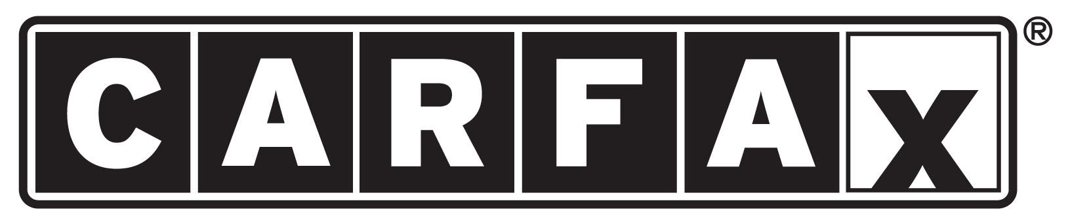
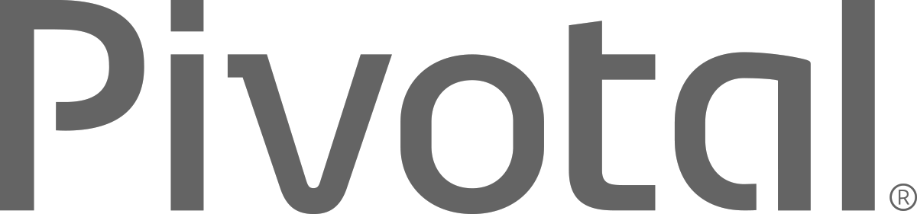
Cloud Native Workshop
Cloud Native Architectures and Frameworks
Notes:
Cloud native applications, and bringing microservice architectures into production in the enterprise.

Slide 2
Agenda
Why?
What?
How?

Slide 3
WHY?

Slide 4





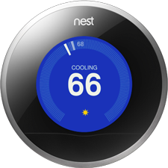
Software is changing industries

Slide 5

CLOUD NATIVE
Agile
Lean
Continuous
Delivery
Microservices
Cloud
DevOps
Notes:
At Pivotal, we really see these trends as manifestations and facets of the same thing – that we call CLOUD NATIVE.
CLOUD NATIVE is the coming together of tools, frameworks and building modern software on a cloud infrastructure

Slide 6
The Promise of Cloud Native
Speed of delivery
Automate middleware
Ease of horizontal scaling
Contract between Application & Platform that creates Promises
Notes:
That is and should be a governing principle behind any cloud platform, library, or tool. Spring Cloud–an open-source library–makes it easy to develop JVM applications for the cloud. With it, applications can connect to services and discover information about the cloud environment easily in multiple clouds such as Cloud Foundry and Heroku. Further, you can extend it to other cloud platforms and new services.
Application Framework
Spring Cloud : used by Netflix
Spring Boot now over 1M downloads a month, historic levels of growth
Runtime platform
Cloud Foundry elastic runtime used by top FS leaders
Enterprise production ready Linux Container based platform
Infrastructure Automation
CF BOSH: Embedded OS, cloud API integrated
Incredible operational leverage; machine to machine automation

Slide 7
WHAT?

Slide 8
Characteristics of Cloud Native Architectures
Continuously Delivered
Twelve Factor Apps (http://12factor.net/)
Microservices
Self-Service agile infrastructure
API-based collaboration
Anti-fragility
Notes:
Continuously Delivered
Twelve Factor Apps (http://12factor.net/)
Microservices
Self-Service agile infrastructure
API-based collaboration
Anti-fragility

Slide 9
Enabling Continuous Delivery
Development
Operations
Idea
Business
Customer
$
Value
QA
Companies that disrupt, reduce time to value

Slide 10
Enabling Agile Delivery
Behavior Analytics
Design
Development
Customer Feedback
Test
Customer Delivery
Notes:
Feedback Loop

Slide 11
WaterScrumFall
Production Release
#1
Waterfall Organization
Production Release
#2
Agile Development

Slide 12
Conway’s Law
“Any organization that designs a system (defined broadly) will produce a design whose structure is a copy of the organization's communication structure.”
- Melvin Conway, 1967
http://www.melconway.com/Home/Committees_Paper.html
Notes:
Inverse Conway Maneuver coined by Thoughtworks - http://jonnyleroy.com/2011/02/03/dealing-with-creaky-legacy-platforms/
Goal is to create self contained, business aligned teams with the smallest feedback loop.
Business capability teams interact with platform operations team via APIs and not meetings. This creates a friction free experience for the business capability team who now have the tools to

Slide 13
Inverse Conway Maneuver Enable Continuous Delivery
Product Mgr.
Dev
UX
QA
DBA
Self
Service
APIS
Sys Admin
Network Admin
Storage Admin
Business Capabilities Team Using Microservices
Platform Operations Team
http://jonnyleroy.com/2011/02/03/dealing-with-creaky-legacy-platforms/
http://www.slideshare.net/adriancockcroft/microservices-the-good-bad-and-the-ugly
Notes:
References:
Inverse Conway Maneuver coined by Thoughtworks - http://jonnyleroy.com/2011/02/03/dealing-with-creaky-legacy-platforms/
http://www.slideshare.net/adriancockcroft/microservices-the-good-bad-and-the-ugly
Notes:
Goal is to create self contained, business aligned teams with the smallest feedback loop.
Business capability teams interact with platform operations team via APIs and not meetings. This creates a friction free experience for the business capability team who now have the tools

Slide 14
Enabling Continuous Delivery
Production Release
ORDERS
Production Release
Production Release
SHIPPING
Production Release

Slide 15
Characteristics of Cloud Native Architectures
Continuously Delivered
Twelve Factor Apps (http://12factor.net/)
Microservices
Self-Service agile infrastructure
API-based collaboration
Anti-fragility
Notes:
Continuously Delivered
Twelve Factor Apps (http://12factor.net/)
Microservices
Self-Service agile infrastructure
API-based collaboration
Anti-fragility

Slide 16
Twelve-Factor Apps
Codebase
Dependencies
Configuration
Backing Services
Build, release, run
Processes
Port binding
Concurrency
Disposability
Dev/prod parity
Logs
Admin processes
APPS
contract
Cloud Platform
Architectural and development practices – http://12factor.net
Beyond the 12 Factor App - https://content.pivotal.io/ebooks/beyond-the-12-factor-app
Notes:
I. Codebase
One codebase tracked in revision control, many deploys
II. Dependencies
Explicitly declare and isolate dependencies (mvn, etc.). Don’t expect servers to have them
III. Config
Store config in the environment. Could you open-source the project w/o revealing secrets?
IV. Backing services
Treat backing services as attached resources. A deploy of the twelve-factor app should be able to swap out a local MySQL database with one managed by a third party (such as Amazon RDS) without any changes to the app’s code
V. Build, release, run
Strictly separate build and run stages. Binary Integrity
VI. Processes
Execute the app as one or more stateless processes
VII. Port binding
Export services via port binding. Routing layer takes care of routes -> ports
VIII. Concurrency
Scale out via the process model
IX. Disposability
Maximize robustness with fast startup and graceful shutdown
X. Dev/prod parity
Keep development, staging, and production as similar as possible
XI. Logs
Treat logs as event streams
XII. Admin processes
Run admin/management tasks as one-off processes

Slide 17
Characteristics of Cloud Native Architectures
Continuously Delivered
Twelve Factor Apps (http://12factor.net/)
Microservices
Self-Service agile infrastructure
API-based collaboration
Anti-fragility
Notes:
Continuously Delivered
Twelve Factor Apps (http://12factor.net/)
Microservices
Self-Service agile infrastructure
API-based collaboration
Anti-fragility

Slide 18
Microservice: Definition
If every service has to be updated in concert, it’s not loosely coupled!
“ Loosely coupled service oriented architecture with bounded contexts"
If you have to know about surrounding services you don’t have a bounded context.
- Adrian Cockcroft

Slide 19
Microservices are NOT
Monolithic Application
Service
Service
HTML
JavaScript
MVC
Enterprise Service Bus
Service
Service
OR
Data Access
Service
Service
Tightly Coupled
Centralized

Slide 20







Microservice Architecture
Relational
DB
HTTP
HTTP
Key/Value
Store
HTTP
HTTP
HTTP
…
AMQP
AMQP
HTTP
Graph
DB
Notes:
REST and message-driven services
Polyglot persistence, services encapsulate data store semantics
Diversity of clients acknowledged
API Gateway for service aggregation, reduced chattiness, protocol translation, reduce latency/round-trips, deal with mobile device fragmentation, build use case/device specific API’s

Slide 21
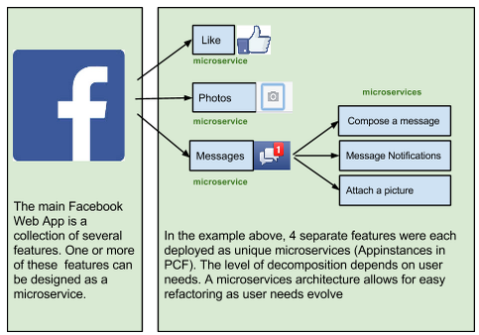
A familiar Microservice example
Notes:
Features can be added, removed, & changed independently, because they’re deployed independently.
Service outages do not affect entire site/app.

Slide 22
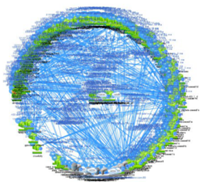
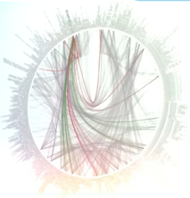

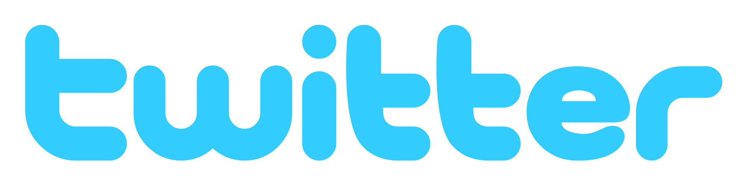
Microservices are hard

Slide 23
Challenges of distributed systems
Configuration Management
Service Registration & Discovery
Routing & Load Balancing
Circuit Breakers for Fault Tolerance
Monitoring
Concurrent API Aggregation & Transformation
Notes:
Everybody faces these, SpringCloudServices takes PCF to the next level

Slide 24
HOW?

Slide 25

It takes a Cloud Native Application Framework
Spring
#1 Enterprise Java App Framework
Netflix OSS
Open Source
Spring Boot
Quick Start
Little to no config.
Opinionated View
Spring Cloud
Distributed Config
Service Registration and Discovery
Fault Tolerance
Routing/Load Balancing
Service Integration
Pivotal is the main custodian of Spring and we hire the main committers for Spring Boot and Spring Cloud. We can bring these resources to bear to help significantly accelerate a customer’s journey to becoming a Cloud Native enterprise
Notes:
#1 Enterprise Java App Dev Framework
Used heavily by Netflix and F2000
OSS, Apache 2.0 licensed
Millions of downloads
Integrated into PCF, BDS

Slide 26
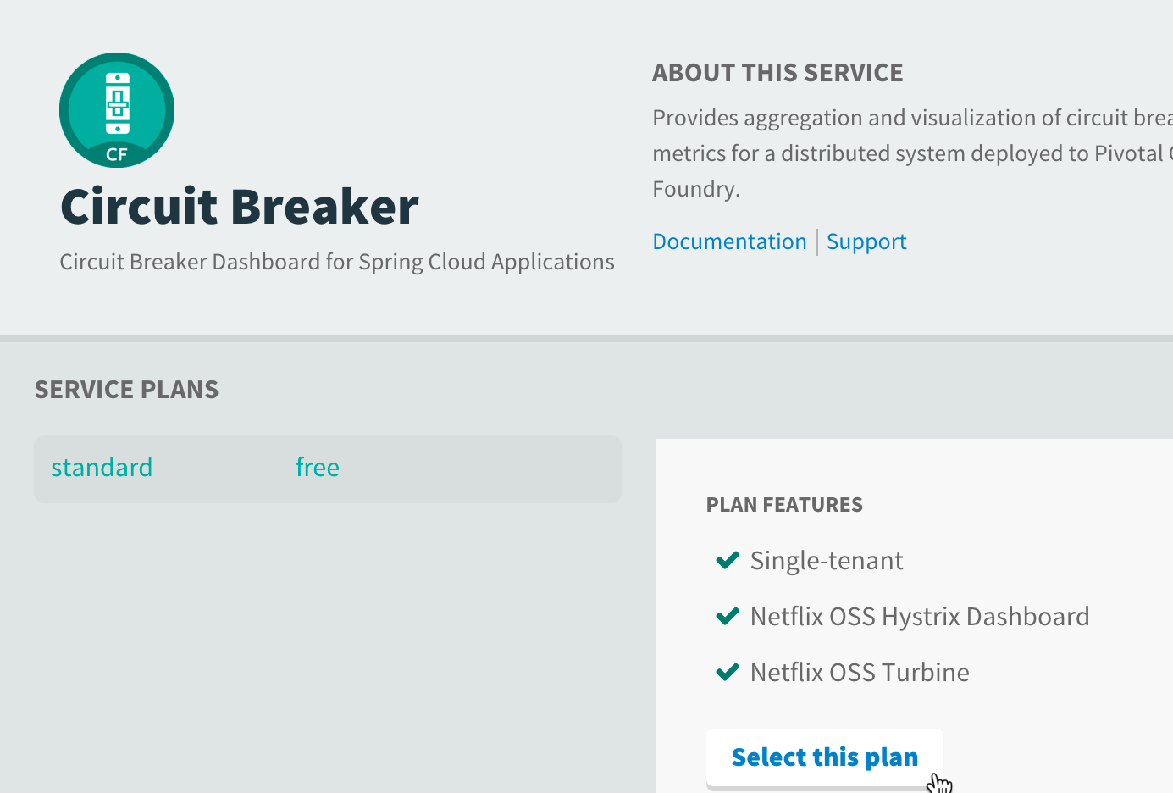
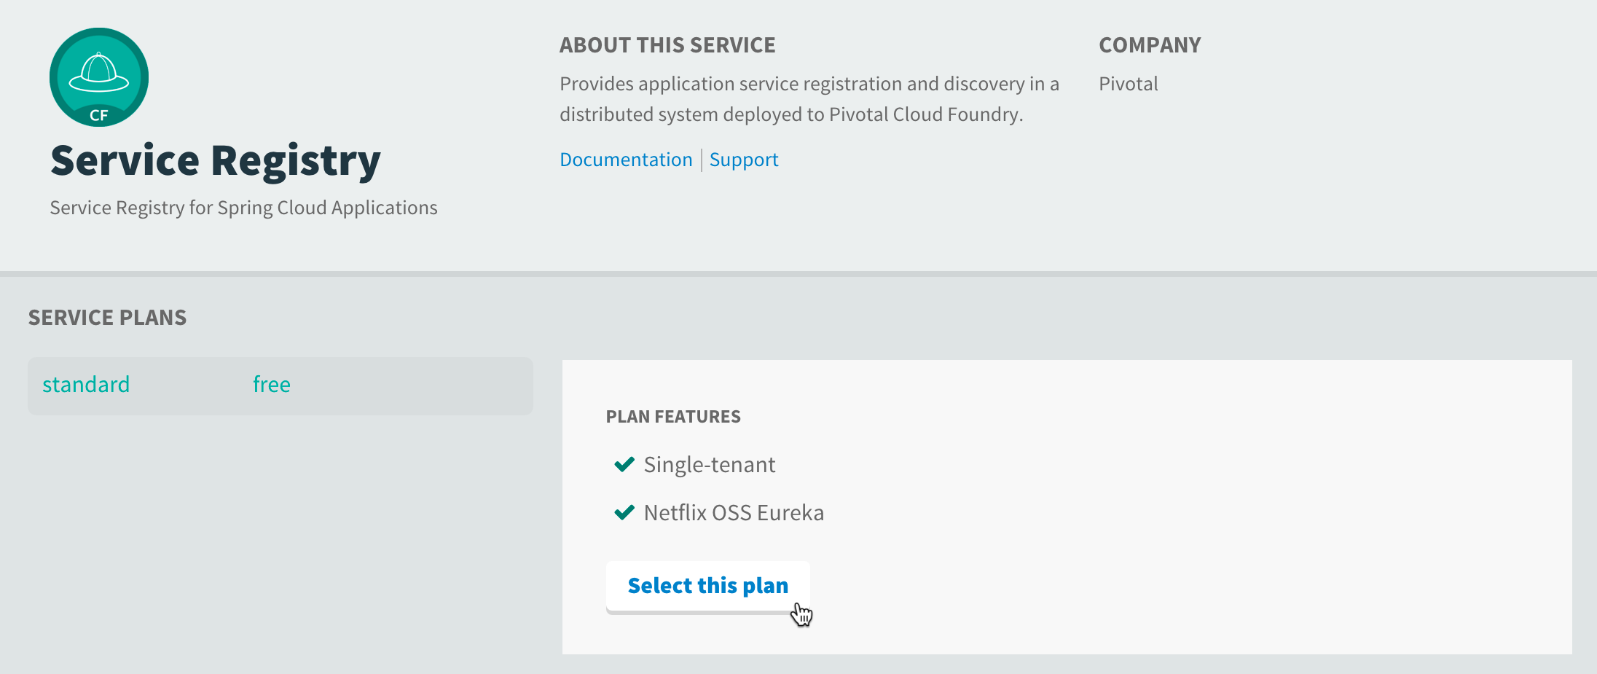

Spring Cloud
Application coordination patterns
Runtimes and their client libraries for:
Configuration Management
Service Discovery
Routing & Load Balancing
Circuit Breakers
Reverse Proxies
….and much more
Security (encrypt, SSO, roles)
Connectors for CF, Heroku, AWS

Slide 27

Companies want to be fast like Netflix
Netflix needed to be faster to win / disrupt
Pioneer & vocal proponent of microservices - the key to their speed and success
Netflix OSS supplies parts, but it’s not a solution
Difficult for enterprises to build it themselves
Pivotal offers the closest thing to “Netflix in a box” today
“Velocity on the JVM is the Killer App”
- Andy Glover (Netflix Eng) @ SpringOne2GX 2014 Keynote
https://youtu.be/xU267-YHN5c?t=1938
Notes:
NetFlix, an undisputed business & technology leader
34% of peak N. American internet traffic from 6-9pm
If speed was why they won, microservices was how
They pioneered / began to popularize micro service concept
All they had was Amazon EC2 back then
They had to invent a distributed platform, cloud native platform with PaaS – like features
They had to invent microservice infrastructure at the application level
All before writing one line of code that relates to the application you and I know as Netflix
NetflixOSS is a talent acquisition and retention strategy, they are in the movie business 1st, and the software business 2nd.
Open source and supporting their developer’s efforts in the industry is how they are able to attract and retain the best engineers, giving them the ability to invent all this stuff.
That’s tough to duplicate.
Detail on Netflix quote: Netflix needed the performance, stability, concurrency of the JVM, but was searching the right RAD capability to give them the velocity they wanted.

Slide 28
It takes a Cloud Native Platform
An end-to-end platform that makes implementing distributed application best practices, a turn-key and first practice

Slide 29

Essential elements of a Cloud-Native Platform
Rapid Provisioning of infrastructure components
Rapid Application Deployment & Management
Scales Horizontally
Basic Monitoring, Logs & Metrics
No-downtime platform upgrades
Dynamic load balancing and routing
Manage supporting services (data, messaging)
Failure detection and health remediation
Notes:
Cloud native applications are an evolution of software development and deployment that embraces DevOps and containers and breaks applications down to smaller individual components. Organizations can develop and deploy faster because there is a modular approach that makes code more efficient and enables much of the common or routine elements to be automated.
There are a variety of “moving parts” involved in doing microservices successfully. Your organization should adopt a DevOps culture and have the appropriate infrastructure in place to avoid getting it wrong. Microservices architecture is generally built on a foundation of cloud and virtualization, and relies heavily on automation to ensure success and avoid failures.

Slide 30
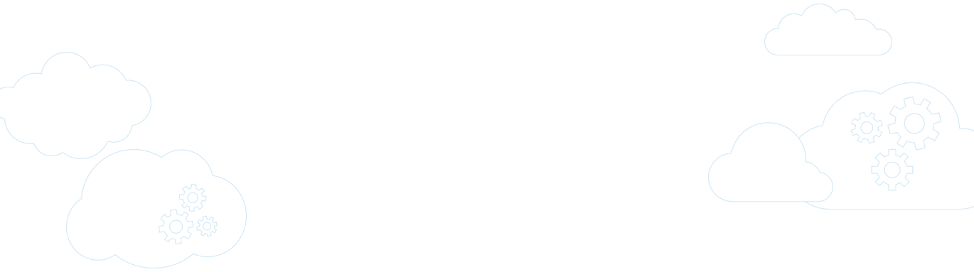

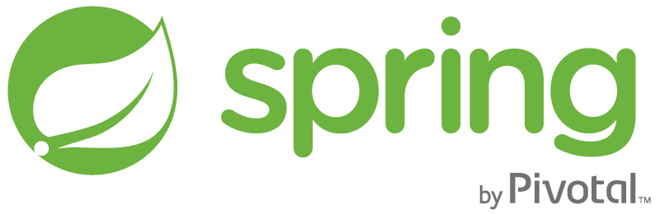
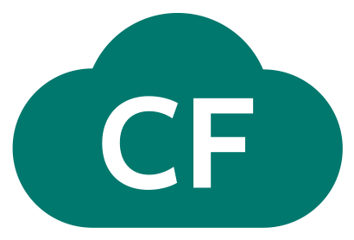
Pivotal Cloud Foundry
A complete framework for delivering software rapidly, consistently and reliably at scale.
Language frameworks designed for microservice architectures with components for service discovery, metrics, circuit breakers and more.
Application Framework
Application container runtime with production-ready backing services, automated build pipeline, routing, health management and logging.
Platform Runtime
Pivotal
Cloud Foundry
API-based infrastructure provisioning that delivers bit-for-bit, consistent, self-healing deployments across private and public cloud.
Infrastructure Automation
Pivotal
Cloud Foundry
Notes:
PCF is the 1st and only cloud native vendor available today

Slide 31


Cloud Foundry Haiku
Here is my source code
Run it on the cloud for me
I do not care how
Notes:
From Onsi Fakhouri

Slide 32
Bosh Haiku
Here are my servers
Go make them a cloud foundry
I do not care how

